Slide 1
CHAPTER 8
Eye colour inheritance in Drosopilla melanogaster

Slide 2
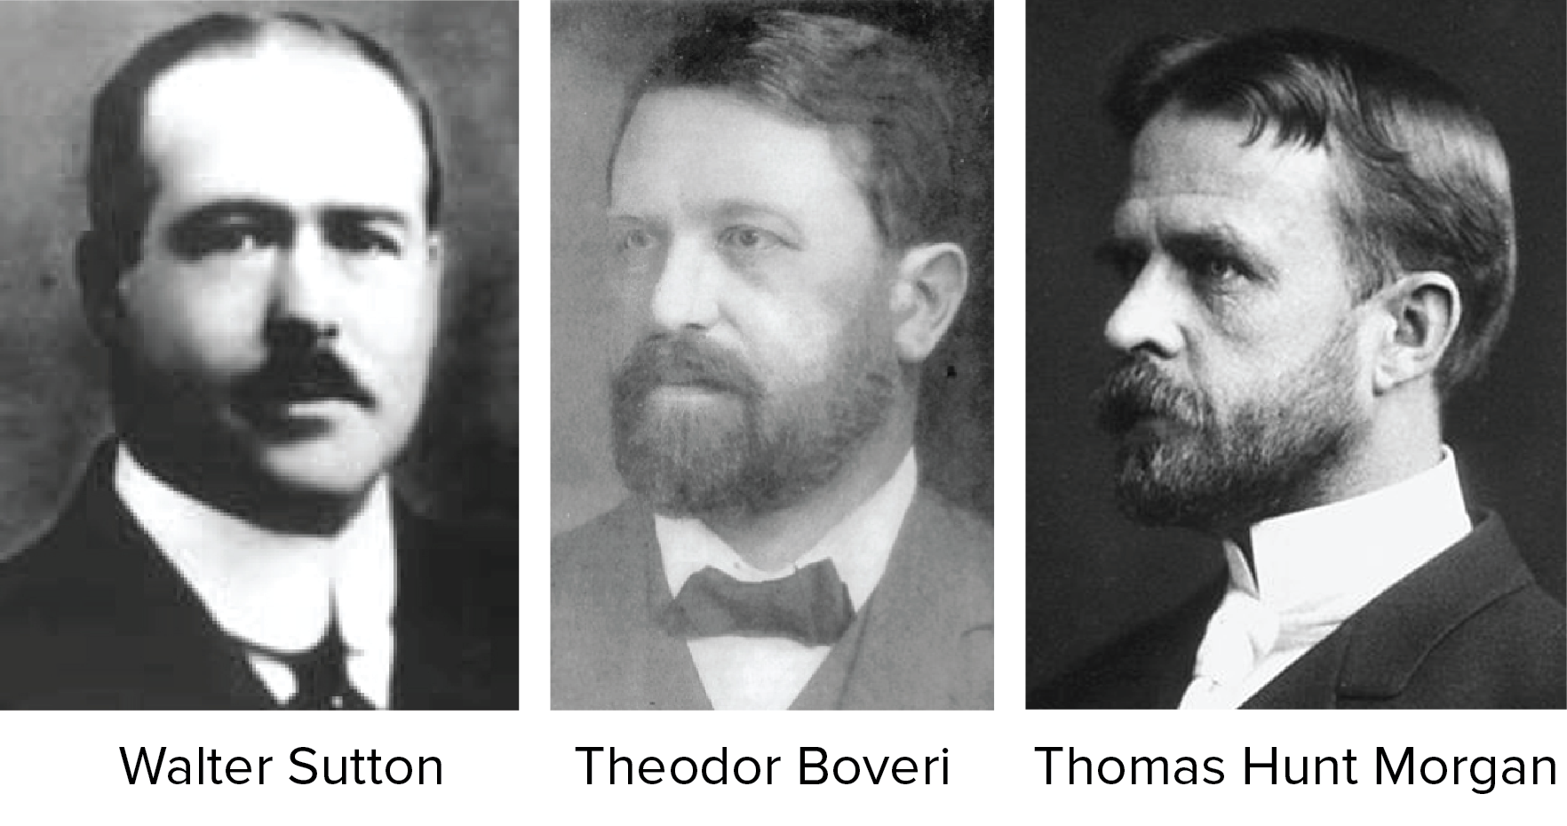
Chromosomal theory of inheritance
In 1902 and 1903, Sutton and Boveri published independent papers proposing what we now call the chromosome theory of inheritance.

Slide 3
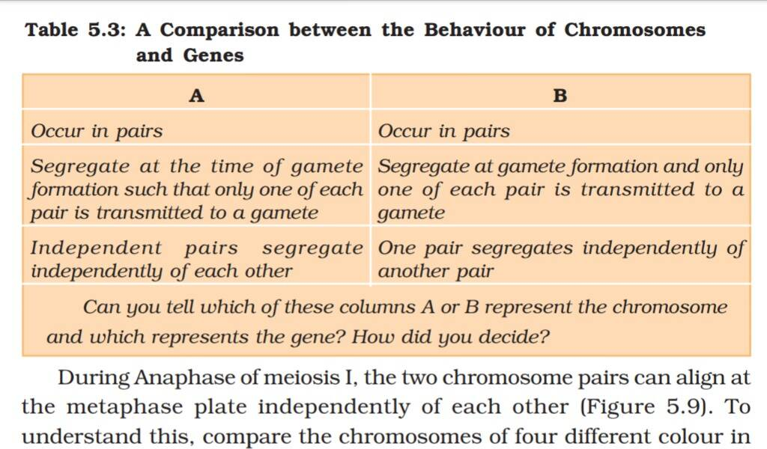

Slide 4
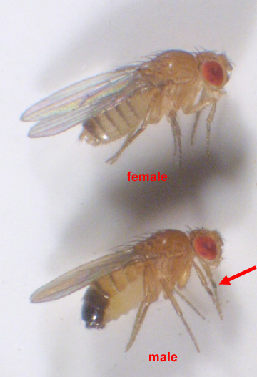
EYE COLOUR INHERITANCE IN Drosophila melanogater REASON FOR CHOOSING Drosophila
4 pairs of chromosomes
Completes it life cycle shortly (24 weeks)
Lays large no.of eggs
Feed on fruits
Male and female looks differently

Slide 5
Male flies VS female flies
male fruit flies | Female fruit flies
Small in size | 25% Large in size
It has one X chromosome and one tiny Y chromosomes | Two X chromosomes
Abdomen rounded at bottom | Pointed towards the bottom
Do not have spike | Have a spike on the dorsal surface at the rear
Have sex comb | No sex comb

Slide 6
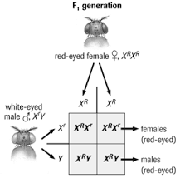
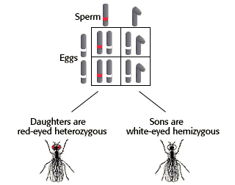
White eye male X red eye female

Slide 7
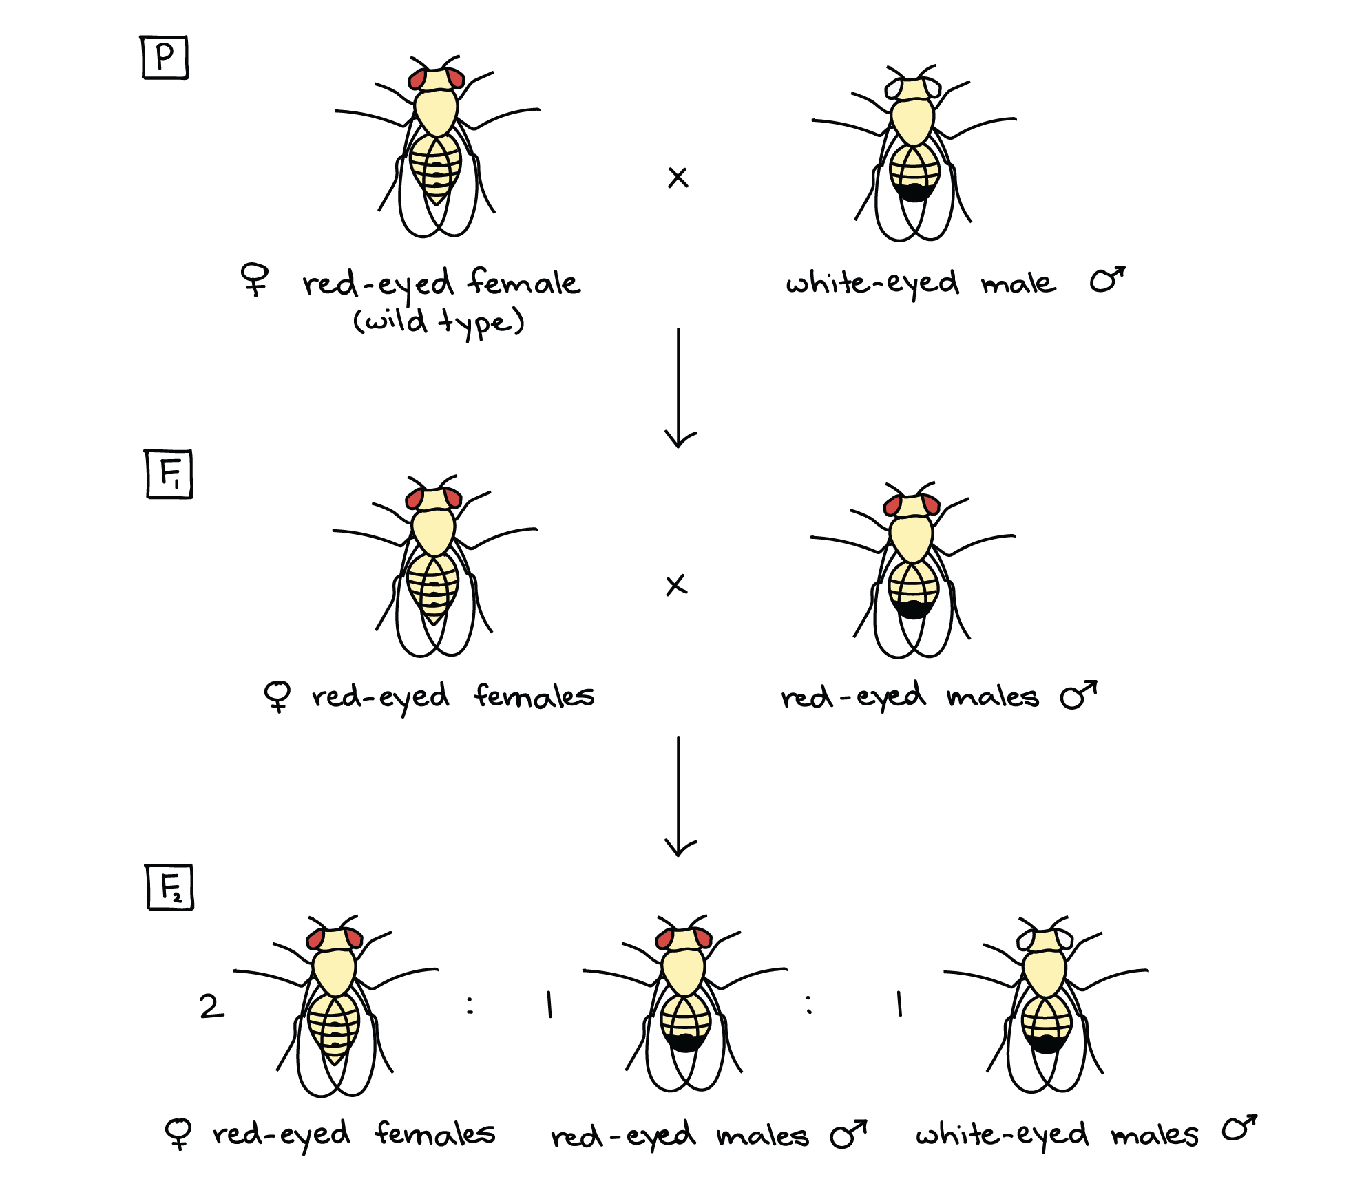

Slide 8
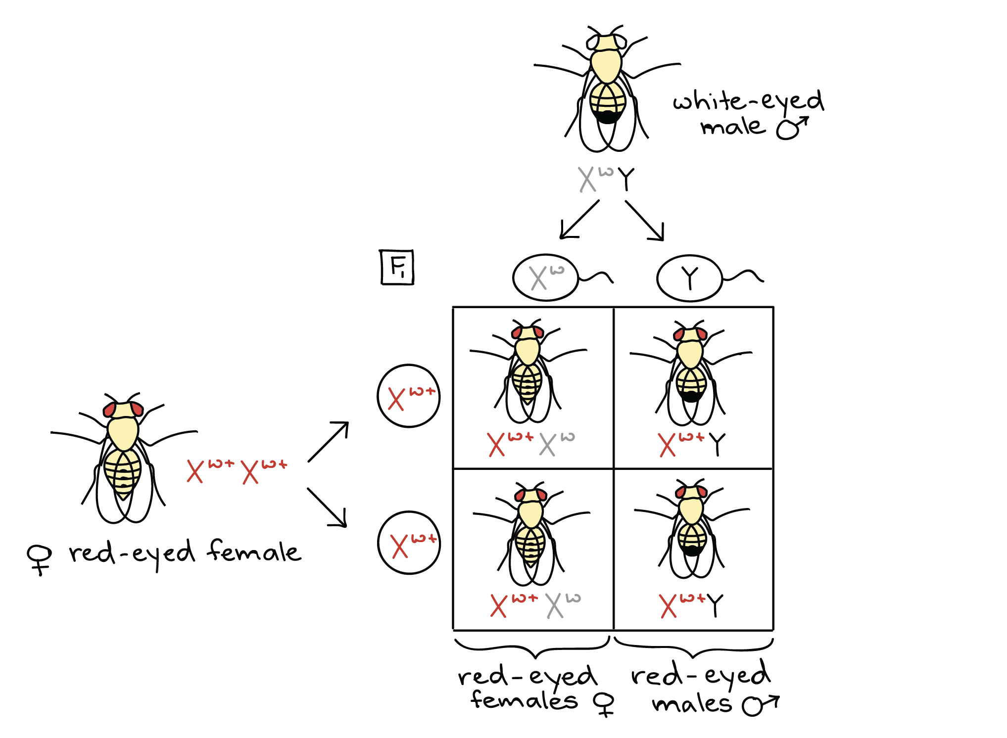

Slide 9
SEX DETERMINATION

Slide 17
